Slide 1

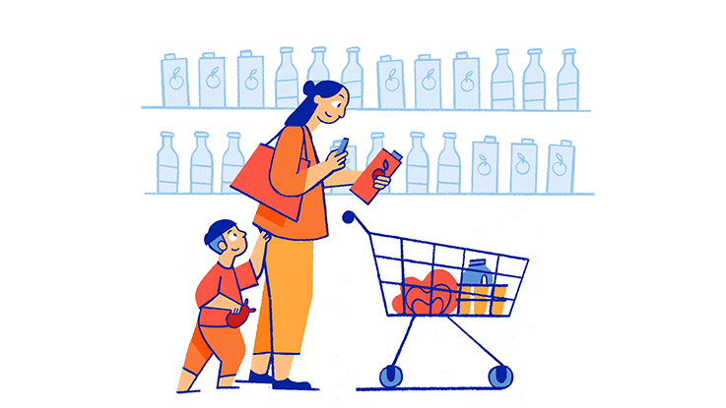
SmartShopper
CSCI 5708 Mobile Computing
April 3rd, 2020
Amoli Nishant B00835717
Mandava Abhinav B00841453
Ponangi Sriram B00851421
Shah Moni B00830791
Tarpara Dhruv B00856253

Slide 2
What is SmartShopper?
The idea that motivated us to develop this mobile application is that, how as students we always try to be frugal with our expenses.
Also, the same is true for many people regardless of their age group or professions.
However, because of a busy schedule it is hard for many people to keep track of the best prices around the city.
That is why we decided to develop an application that can make it possible while not worrying about wasting any time.

Slide 3
Why is SmartShopper needed?
SmartShopper provides the information about the cheapest groceries and other household products by comparing the prices from various stores.
Application Benefits:
Provides an economical shopping experience.
Provides a feature to scan the barcode of a product to lookup.
Shows the location of the store that is selling the desired product for the best price.
Uses Google map in order to help the user find their way to the store.

Slide 4
Target Audience
This application has been developed keeping in mind the people who try hard to be economical with their expenses.
Low-income group such as students as well as the working professionals with moderate income.
Also, at this moment the scope of this application is limited to Halifax city as for any product, only the prices from stores within the Halifax region will be compared.

Slide 5
Usage Environment
SmartShopper app requires internet connectivity.
As long as the user stays connected, the app can be used from anywhere.
Users are more likely to use the app from home, before going out for buying stuff they need. Also, staying connected to the network is not critical for the app as users can use the app once the connectivity is back. Connection drop and sudden non-usability of this app has minimal impact on user's state of mind.

Slide 6
Primary Features
Search Product by name
Search Product by barcode
Show Product Details
Shopping List
Navigate to nearest store.

Slide 7
Business Model:
Application will be available on the google play store if uploaded.
Application is currently available on Gitlab repository (https://git.cs.dal.ca/tarpara/smartshopper.git )
We are adopting the Free Model that is completely free (No ads as well)

Slide 8
Usability
Help and Documentation provided
Ease of Use – Simple User Interface
Simple Navigation
Clear and Concise Content
Complete onboarding – Using the Intro Slides

Slide 9
Accessibility
This application can be run only in a device with Android Nougat and beyond with covers 86% of all android devices.(https://gs.statcounter.com/android-version-market-share/mobile-tablet/worldwide)
Requires internet connection to work.
Requires camera for best results.

Slide 10
Security & Legal compliance
Only the Camera permission is requested to scan barcode.
The location permission is not needed by this app since the store location will be shown using the google maps app.
The images captured by barcode scanner processed locally.

Slide 11
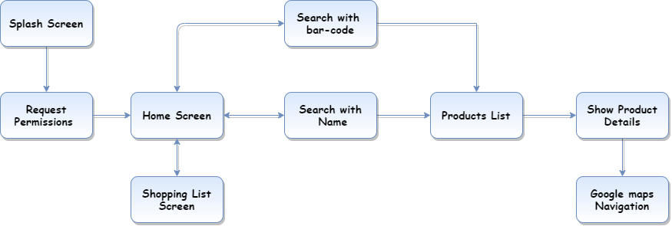
Application Flow

Slide 12
Limitations
Cannot sort the products by closest store due to free API key limit.
Cannot search multiple products at once.
Does not open the google maps within the application.
Does not fetch the actual prices of the product since the product details API is mocked.

Slide 13
Planning
Feasibility Analysis, Potential Risk and Mitigation:
SmartShopper is an application which compares the prices of commodities across different stores. Hence, the data required shall be accessed via the stores' API.
In the case of restricted API access, the app can be made to work with mock data and can satisfy the functional requirements.
Since the data are loosely coupled from the application, the app can be developed but requires adjustments in the schedule to accommodate time for data modelling and mock data creation.

Slide 14
UI/UX Design
Material Design
SmartShopper follows material design guidelines provided by Google, for improving user experience in mobile application (https://material.io/design/)
This app also implements dynamic duration for animations (Introduction Slides), which makes content easy to follow for users.(https://material.io/design/motion/speed.html#duration-easing-dynamic-durations)
Wireframe
Wireframes are designed considering users' behavior while shopping. HomeFragment is at the center since users tend to search the product by name most of the times. BarcodeScanner is on the right as users tend to search for any camera-based functionality to be accessed from either the center or on the side on which the camera is present (right for most of the phones)
BottomNavigation and other elements that requires user interactions are placed according to material design guideline, to make them easily reachable in modern large screen smartphones.

Slide 15
Prototyping & Development
The app had two prototypes for products list screen.
The first prototype used recycler view with card view.
In the second prototype, we used recycler view with folding cell view.
We discarded the first prototype and adopted the second prototype.
We also created a protype for google maps within an activity.

Slide 16
Testing
App was rigorously tested by:
End-To-End Testing
Manual Testing
Integration Testing
Chaos Testing

Slide 17
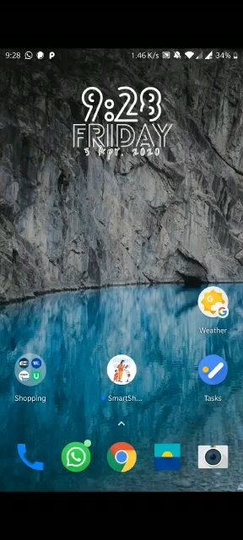
Application Demo

Slide 18
Conclusion
Developing Smart Shopper was a great journey.
During the development process we learnt a lot about project deliverables, working on Version controls, Android App Development and finally the essence of teamwork.
Accepting and considering each other views was the most important quality we learned and developed during the app development.
SmartShopper is an application which strives to provide our users with the information about the cheapest groceries and other household products by comparing the prices from various stores.
Developing this application gave us all a real time exposure to industry projects and how to deal with last moments chaos.

Slide 19
Thank You

